Slide 1

Is Reading More with a Child Associated with Family Resilience?
Does this vary across education level of the parent?
Author 1, Author 2 & Kelly Quinn

Slide 2
Introduction
What we think we know:
Family resilience helps families overcome adverse experiences
Parent-child bonding contributes to family resilience
Shared reading time helps strengthen the parent-child bond
Education level of the parent has a role to play

Slide 3
Introduction
Potential Confounding
Financial Hardship
Other Caregiver
Religious and Emotional Support

Slide 4
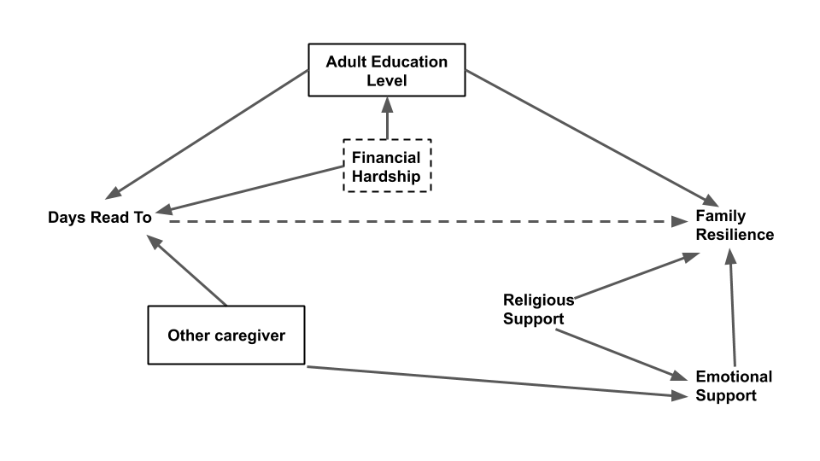
Methods
NSCH 2018 Study Data
A complex survey linear regression model between our composite ‘Family Resilience’ variable and our ‘Number of Days Read To’ was run.
A maximal model was run with all covariates except ‘Religious Support’ and ‘Emotional support.’
Interactions were tested between ‘Adult Education level’ and ‘Number of Days Read To’

Slide 5
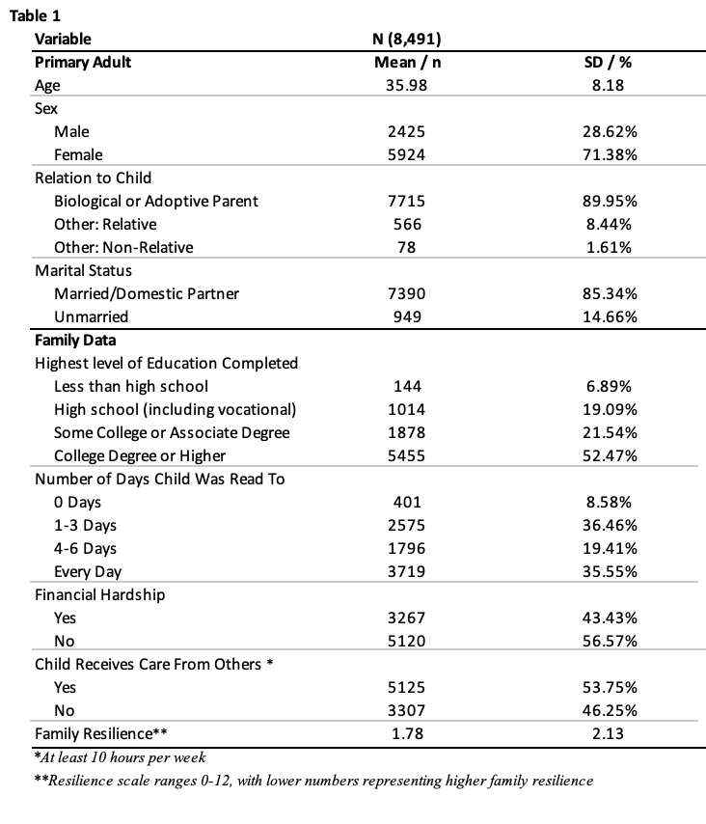
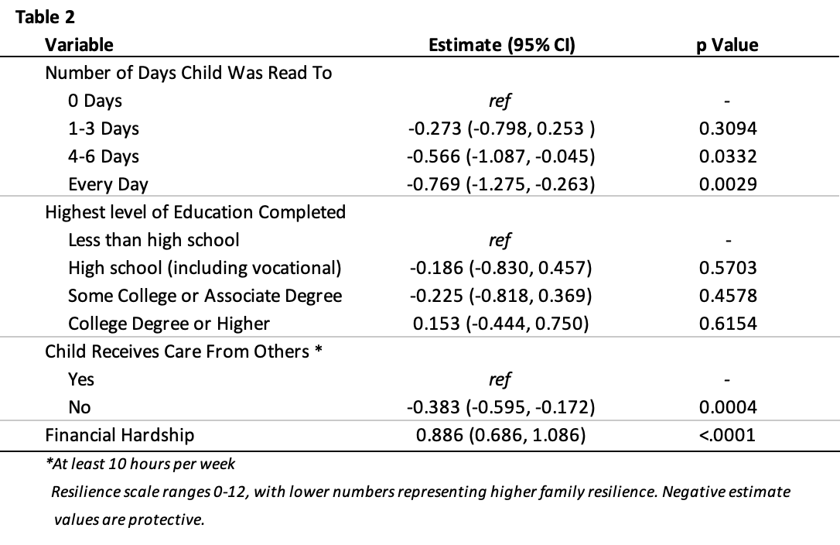
Results

Slide 6
Results
Interaction test between ‘Adult Education Level’ and ‘Number of Days Read To’ was non-significant.
A second model was chosen, dropping the interaction term, and produced the overall results seen in Table 2.
Notable findings:
‘Number of Days Read To’ had a significant, protective effect for ‘4-6 Days’ (p Value: 0.0332) and ‘Every Day’ (p Value: 0.0029).
Levels less than 4 days read to were non-significant.
Adult education was non-significant at every level.
The absence of outside child care had a significant, protective effect (p Value: 0.0004)
The family experiencing financial hardship had a significant, harmful effect on Family Resilience (p Value: <0.0001)

Slide 7
Discussion
Reading to young children 4+ days a week has shown a statistically significant positive association with family resilience
Reading is not only good for literacy skill building but is also an important family bonding activity that aids families in overcoming adverse events and hardships
Limitation- study focused on resilience of the family unit as a whole
Further studies- Explore reading time with any bonded caregiver and child resilience

Slide 8
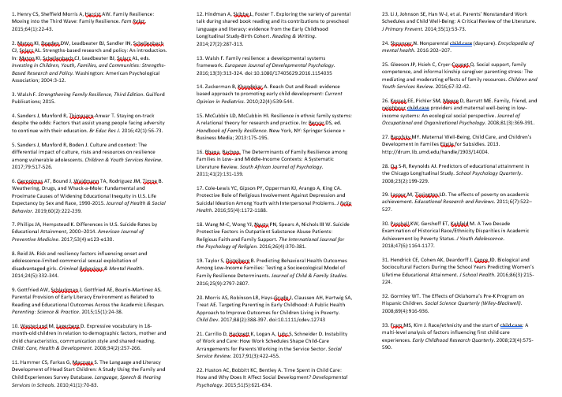
References

